Slide 1

Philosophy of Static Typing
-Ruby vs. TypeScript-
Composed By: Hayato Ishida
For Japanese version, click here
Updated On: 24 June 2025

Slide 2

About Me
Accounts
GitHub: @hayat01sh1da
X: @hayat01sh1da
LinkedIn: @hayat01sh1da
Speaker Deck: @hayat01sh1da
Docswell: @hayat01sh1da
Occupation: Software Engineer
Things I Am Into
Linguistics
Singing at Karaoke
Listening to Music
Watching Movies
Cat Feeding

Slide 3
Licences / Certifications
English
TOEIC® Listening & Reading 915: Certified on December 2019
Engineering
Information Security Management: Certified on November 2017
Applied Information Technology Engineer: Certified on June 2017
Fundamental Information Technology Engineer: Certified on November 2016
IT Passport: Certified on April 2016
Others
Abacus 2nd Class: Certified on June 2002
Mental Arithmetic 3rd Class: Certified on February 2001

Slide 4
Skill Stack
Languages
Japanese: Native Proficiency
English: Full professional Proficiency
Development
Backend: Ruby(Ruby on Rails), Python
Frontend: TypeScript + React.js, TypeScript +Vue.js
Database: MySQL, PostgreSQL, MongoDB
Architecture: Monolith, Modular Monolith
Hosting: AWS ESK
Versioning: Git, GitHub
CI/CD: GitHub Actions, ArgoCD
Monitoring: Datadog, Sentry

Slide 5
Work Histories
Period | Genre | Position | Jobs
Aug 2021 - Present | Saas(Educational Service) | Software Engineer | Backend Development Frontend Development CI/CD Maintenance Weekly Release Manager Troubleshooting Documentation Technical Debt Resolution Tech Blog Entries LT Speaker
Feb 2020 - Dec 2020 | SaaS(Chatbot Platform) | Backend Engineer | Backend Development Documentation Technical Debt Resolution Inspection of Alternative API

Slide 6
Work Histories
Period | Genre | Position | Jobs
Jun 2018 - Jan 2020 | Contract-basis Developer | Software Engineer | Backend Development Frontend Development Troubleshooting Quality Assurance Tech Blog Entries
Apr 2016 - Jan 2018 | System Engineering Service | System Engineer | Corporate Account Admin Windows Server Maintenance Security Admin Assistant Internationalisation / Localisation

Slide 7
International-Exchange Activities
Activities in University
English Linguistics Seminar(Focusing on Mass Media English)
International-Exchange Clubs(The 2nd Year)
International-Exchange Programmes conducted by Japan Cabinet Office(2013 - 2016)
Japanese Linguistics Course(The Final Year)
Overseas Life Experience
Working Holiday in Australia(April 2014 - March 2015)
Language School for 1 month in Sydney
Work for 6 Months in Hamilton Island Resort
Volunteering for 1 Month as Assistant Teacher of Japanese Language at St Ives High School in NSW
Other Activities
Keep Everyday Journal in English (April 2014 - Present)
Sunrise Toastmasters Club(February 2017 - March 2018)
Vital Japan(January 2018 - July 2019, October 2022 - February 2023)
Self Learning and Training of English Language
Participation Ruby-Related Tech Conferences

Slide 8
Agenda
The Basics of Static Typing
The Typing Ecosystem
The Typing Philosophy
Summary
References

Slide 9
1. The Basics of Static Typing

Slide 10
1. The Basics of Static Typing
Trade-offs
👍Protects a system and/or program from ABEND(Abnormal End) and security holes caused by Undefined Behaviours
👍 Detects TypeError prior to a code execution
👍Guards large-scale codebase more efficiently from such Nasal Demons as bugs, type inconsistency and unsafe refactoring
👎Worsens performance due to a huge overhead because it checks the type of a receiver every time in some processing system(e.g., JavaScript), such as `x.foo()`
👎Forces developers to maintain not just codes but type declarations
👎Brings developers another learning costs to master how to make it work

Slide 11
1. The Basics of Static Typing
Category | Timing of Type Inspection | Language
Static Typing | Prior to code execution | TypeScript C Rust Java Swift etc.
Dynamic Typing | During the code execution | Ruby JaveScript Java Swift etc.

Slide 12
2. The Typing Ecosystem

Slide 13
2. The Typing Ecosystem
Ruby
System | Gem | Description
RBS | RBS(Ruby Signature) | An official gem of which language to describe the structure of Ruby programs. Not DSL of Ruby but another language.
 | Steep | Checks types according to definitions on RBS
 | TypeProf | Infers definitions in RBS according to Ruby codes
 | rbs-inline | Generates RBS by inline comments on Ruby codes
RBI | RBI(Ruby Interface) | Provides a Ruby API to compose Ruby I/F files for Sorbet
 | Sorbet | Provides existing Ruby codes with gradual typing and quick response with errors and suggestions
 | Tapioca | Compiles RBI files via not just Ruby source codes but Gems, Rails and other DSLs

Slide 14
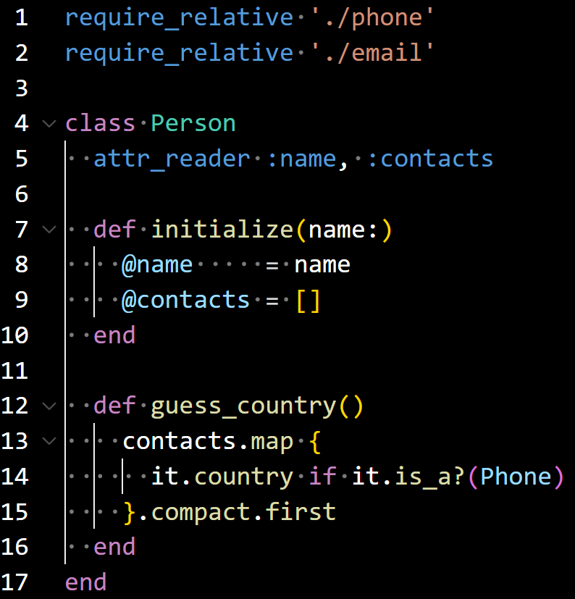
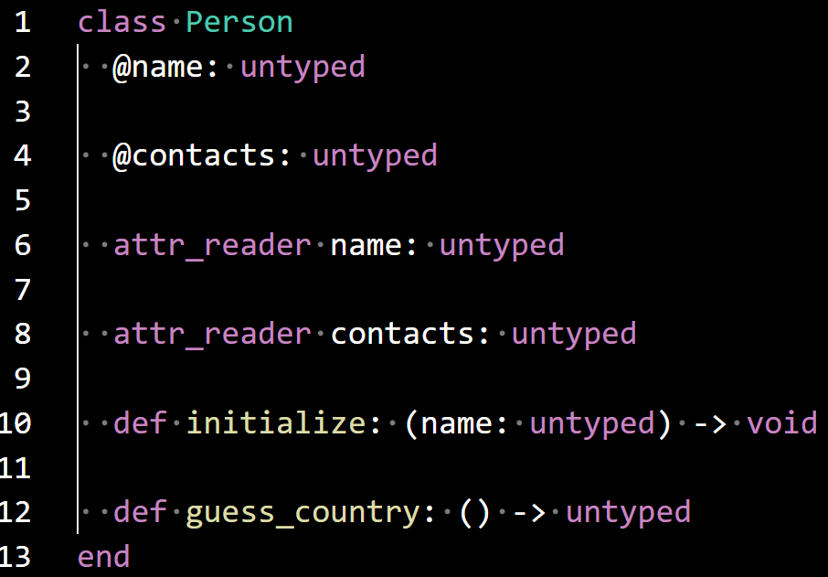
2. The Typing Ecosystem
Ruby: RBS + Steep
e.g. RBS + Steep
person.rb
sig/person.rbs
$ rbs prototype rb person.rb
$ steep check
# Type checking files:
...
No type error detected. 🫖

Slide 15
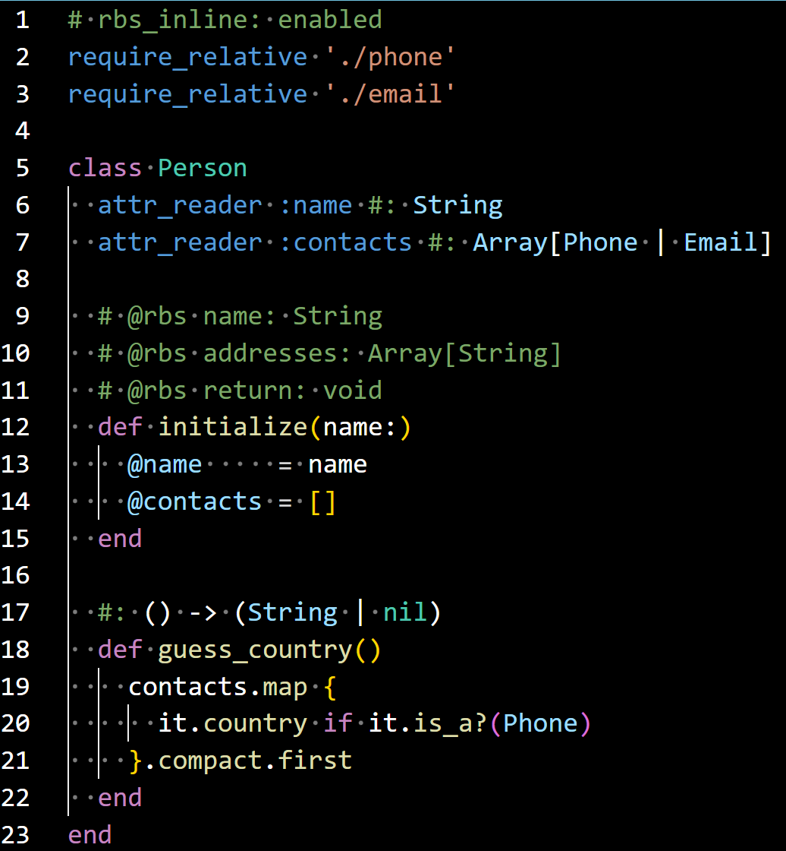
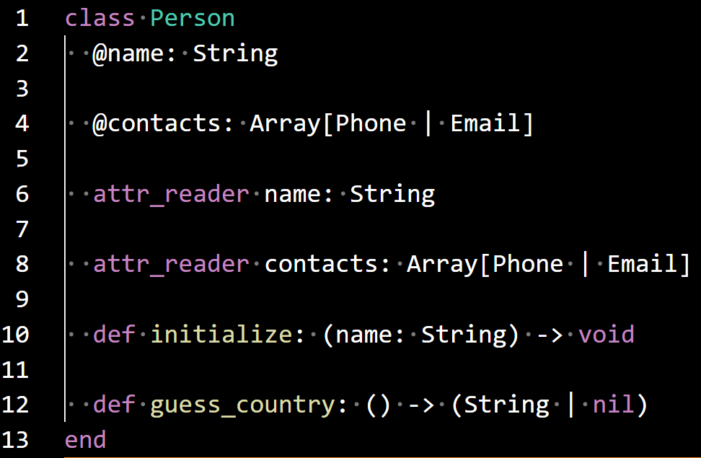
2. The Typing Ecosystem
Ruby: RBS + Steep
e.g. rbs-inline + Steep
person.rb
sig/generated/person.rbs
$ rbs-inline --output person.rb
🎉 Generated 1 RBS files under sig/generated
$ steep check
# Type checking files:
...
No type error detected. 🫖

Slide 16
2. The Typing Ecosystem
TypeScript
On one hand, Ruby has not embraced another ecosystem than RBS yet in order to keep backward compatibility in terms of its syntax.
On the other hand, TypeScript dynamically changed JavaScript's ecosystem by introducing Generics, Object Types and Interfaces.
The drastic update broke an implicit assumption that we must introduce type check without making any differences in existing code, mentioned Mr. Sotaro Matsumoto(@sotaro), a Ruby Committer, in a blog article.
He also referred to the fact that it was because JavaScript had already been well-organised in terms of its rich libraries and development environment with high functionality, which made it possible to change existing JavaScript codebase to that of TypeScript.

Slide 17
3. The Typing Philosophy

Slide 18
3. The Typing Philosophy
Ruby
In a blog article posted by a Developer Advocate at Heroku Mr. Jonan Scheffler, the creator of Ruby Mr. Yukihiro Matsumoto, generally called Matz, mentioned the introduction of static typing to Ruby as follows.
It proves his philosophy of Ruby which thinks highly of rich coding experience leading to developer's happiness and backward compatibilities.
Jonan) So, along with the JIT, you've also talked about some type changes to coming to Ruby 3 and the optional static types. Can you tell us about that?
Matz) Yeah, the third major goal of the Ruby 3 is adding some kind of static typing while keeping the duck typing, so some kind of structure for soft-typing or something like that. The main goal of the type system is to detect errors early. So adding this kind of static type check or type interfaces does not affect runtime.

Slide 19
3. The Typing Philosophy
Ruby
In fact, RBS is independent ecosystem of Ruby itself and the signature is a different language from it.
`xxx.rbs` is separate from the corresponding `xxx.rb` and rbs-inline treats type definitions as comment so does not affect existing Ruby codes while it provides more meanings than semantic description.
In my opinion, the concept of rbs-inline is very developer-friendly as follows.
Static typing plays a role in a document
The type of return value should be articulated especially on an app used as a web API
Inline comments of rbs-inline is literally "get two for the price of one"

Slide 20
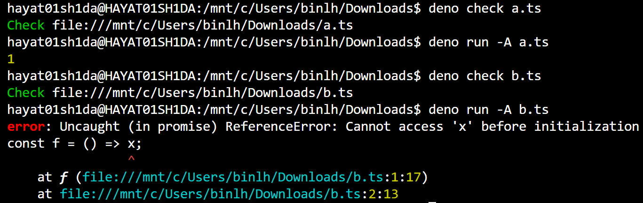
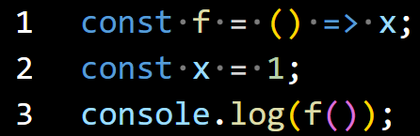
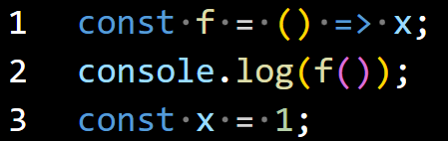
3. The Typing Philosophy
TypeScript
On p.3 of his book型システムのしくみ - TypeScript で実装しながら学ぶ型とプログラミング言語, Mr. Yusuke Endo, a Ruby committer, mentions the philosophy that TypeScript focuses only on detection of undesirable behaviours as long as it is reasonable and does not drastically change the traditional JavaScript coding experiences.
For example, Both of afterword variable definition below raise no error in type checking, but the latter raises ReferenceError in execution.
WSL
a.ts
b.ts

Slide 21
3. The Typing Philosophy
TypeScript
This phenomenon illustrates uninitialized variables can be referred to by already defined functions.
Such a type unsafety should be detected in type-check system, but TypeScript is willing to ignore it.
Why?
According to the author, JavaScript has traditionally allowed this kind of implementation, so restriction on uninitialized variables in TypeScript can ruin of backward compatibilities with JavaScript.
It proves TypeScript values traditional coding experiences as well as Ruby.

Slide 22
4. Summary

Slide 23
4. Summary
Both Ruby and TypeScript try hard to guarantee traditional coding experiences by keeping backward compatibilities
TypeScript succeeded in integration of static typing ecosystem by dynamic introduction of Generics, Object Types and Interfaces
Ruby has 2 big streams of static typing system, RBS(Ruby Signature) and RBI(Ruby Interface) ecosystems. No winner of Natural Selection and Survival of the Fittest yet
In any case, developers can enjoy a lot more benefits by static typing than they expect, so it is highly worth of installation

Slide 24
5. References

Slide 25
5. References
いかにして動的型付けの Ruby に静的な型検査を持ち込むか？ Steep と RBS が目指すもの
Last Accessed On: 06 June 2025
RubyKaigi 2025 初参加エンジニアのための Ruby 静的型付けガイド
Last Accessed On: 06 June 2025
The State of Static Typing in Ruby in 2025
Last Accessed On: 06 June 2025
Why Static Typing is Essential for Efficient Ruby and Rails Development
Last Accessed On: 06 June 2025
Static Typing in Ruby: It's Not a Cult, It's a Choice (You Should Probably Make)
Last Accessed On: 06 June 2025

Slide 26
5. References
Ruby 3×3: Matz, Koichi, and Tenderlove on the future of Ruby Performance
Last Accessed On: 06 June 2025
RBS(Ruby Signature)
Last Accessed On: 06 June 2025
Steep
Last Accessed On: 06 June 2025
TypeProf
Last Accessed On: 06 June 2025
rbs-inline
Last Accessed On: 06 June 2025
RBI(Ruby Interface)
Last Accessed On: 06 June 2025

Slide 27
5. References
Sorbet
Last Accessed On: 06 June 2025
Tapioca
Last Accessed On: 06 June 2025
TypeScript Official Documents
Last Accessed On: 06 June 2025
10 Must-Know TypeScript Features to Improve Your Coding Efficiency
Last Accessed On: 06 June 2025
Yusuke Endo, 型システムのしくみ - TypeScript で実装しながら学ぶ型とプログラミング言語, Tokyo, Lambda Note Ltd., 2025

Slide 28
EOD

